Slide 1
Recommendation of neighbourhoods for restaurant opening

Slide 2
PROBLEM
Data that might contribute to determine where to open a restaurant for someone who is planning to open a restaurant in a given city. This project aims to predict the correct neighbourhood in the city where a restaurant can be opened.

Slide 3
Data section
New York City data that contains list Boroughs, Neighbourhoods along with their latitude and longitude.
Data source : https://geo.nyu.edu/catalog/nyu_2451_34572
Description: This data set contains the required information. And we will use this data set to explore various neighbourhoods of New York City.

Slide 4
Restaurants in each neighbourhood of New York City:
Data source : Foursquare API
Description: By using this API we will get all the venues in each neighbourhood. We can filter these venues to get only Indian restaurants.

Slide 5
Methodology section
The data which is obtained for the data section is then used to process the information. Foursquare API is used to get all the restaurants which are there in New York City. Thus this information can be fitted to all the neighbourhoods. The Foursquare API allows application developers to interact with the foursquare platform. The API itself is a REST full set of addresses to which you can send requests, so there's really nothing to download onto your server.
The foursquare API needs client id and server to request for the restaurants.
URL is used to search for all the restaurants in the given city using search query option in the foursquare API URL.

Slide 6
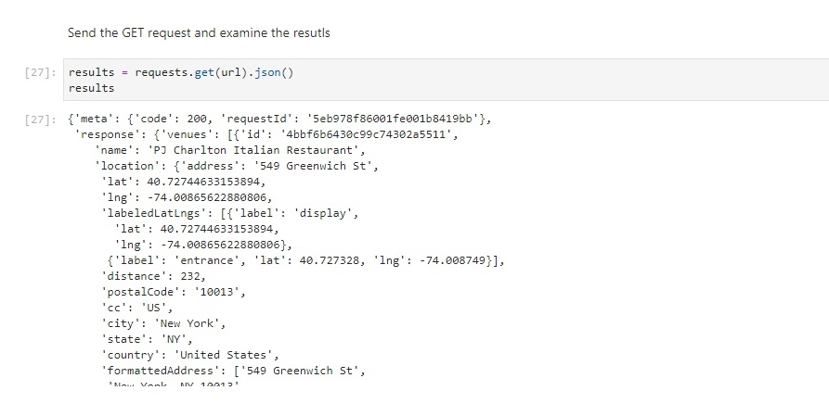
The collected data is obtained in the results section with the GET request which is used to extract the collected data in the json format.

Slide 7
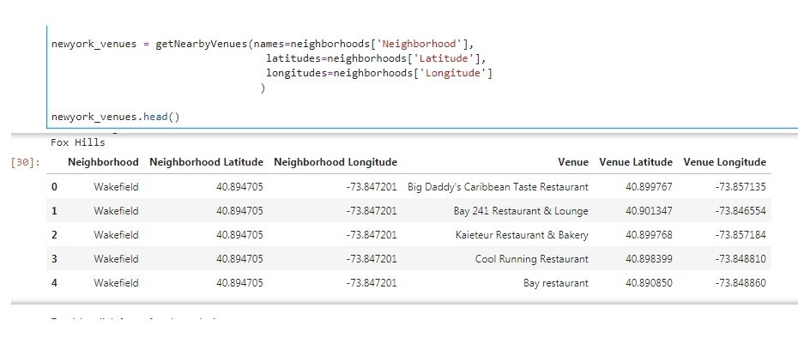
Thus the obtained json data is now converted into the data frame which can be merged to our New York data.

Slide 8
K-means clustering algorithm
K-means clustering is a method of vector quantization, originally from signal processing, which aims to partition n observations into k clusters in which each observation belongs to the cluster with the nearest mean, serving as a prototype of the cluster.
We here try to divide the neighbourhoods into 3 clusters where one cluster shows about the neighbourhoods with very less restaurants and the second cluster shows about neighbourhoods with medium restaurants and the last cluster tells about the neighbourhoods with many types of hotels and restaurants.

Slide 9
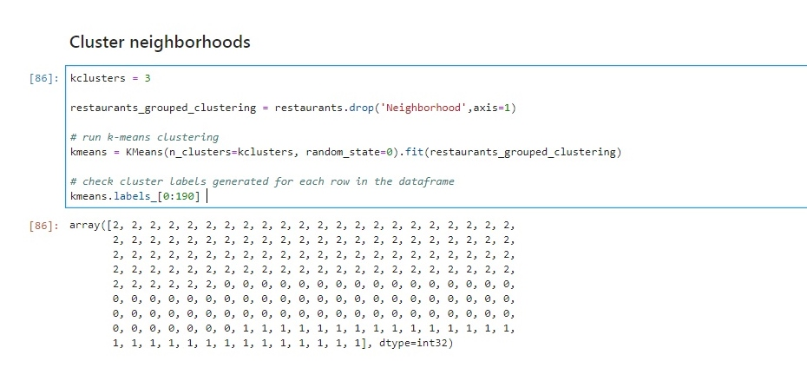
Thus the labels are provided to the neighbourhoods, if the label is 2 then there are less restaurants in the neighbourhood similarly if it is 1 then medium and if it is 0 then there are plenty restaurants around the neighbourhood.

Slide 10
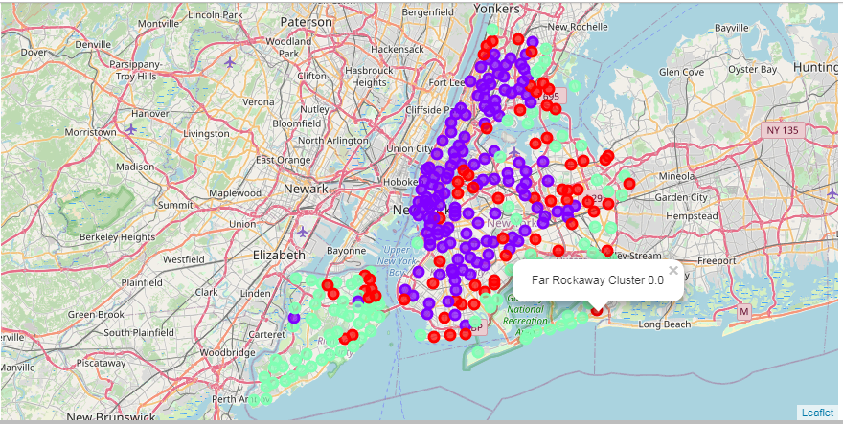
Results
The result section consists of the different neighbourhoods at different cluster labels. These are used by the person who is planning to open a restaurant. He uses the cluster label consisting of the neighbourhoods with less number of restaurants to open his/her restaurant.
The green circles are for the areas with less restaurants, violet one with moderate and red one with plenty of restaurants.

Slide 11
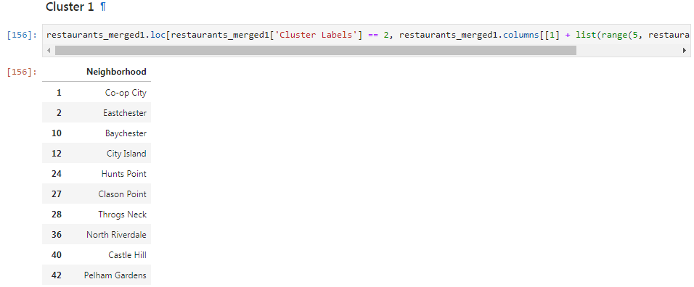
Conclusion
Thus based on the results section, this project concludes all the neighbourhoods which are great to open a restaurant as those neighbourhoods have very few restaurants and hotels. Thus it makes a great place in those neighbourhoods for anyone who is willing to open a restaurant or a hotel

